Slide 1
Distributed Architecture

Slide 2
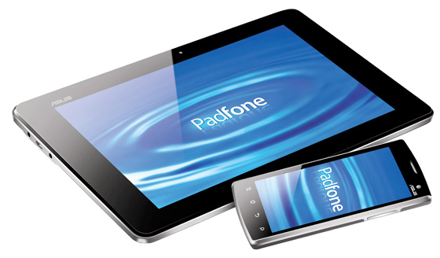



Distributed Application Architecture
Targeted Apps
Mobile
Distributed
Application
Services
Communication Interface
Power Apps
Desktop / Web

Slide 3
Communication Interface
 | Standard | Performant | Scalable | Supported | Total
HTTP/S | 5 | 3 | 5 | 5 | 18
TCP | 0 | 5 | 5 | 3 | 13
Event Hub | 2 | 5 | 5 | 5 | 17
Azure Queue | 2 | 3 | 5 | 5 | 15
Service Bus | 2 | 3 | 5 | 5 | 15
WCF/SOAP | 5 | 1 | 5 | 5 | 16

